Slide 1
Storage In a Nutshell

Slide 2
Before all of that though…
Final project and end of year class schedule:
Nov 16^{th -} Class 13 – “Storage In a Nutshell” and intro to the final project
Nov 23rd - Thanksgiving break, no class
Nov 30th - Class 14 – “Linux Architecture”, final project first draft due
Dec 7^{th -} Class 15 – Final project work session and last draft due
Dec 14th - Last day of finals, no class. Final project due

Slide 3
Storage In a Nutshell

Slide 4
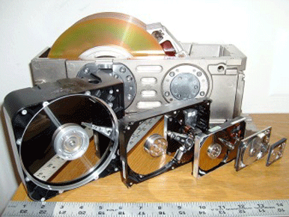
State of the Art Hardware
Notes:
1980: IBM introduces the first gigabyte hard drive. It is the size of a refrigerator, weighs about 550 pounds, and costs $40,000.
1983: Rodime releases the first 3.5-inch hard drive; the RO352 includes two platters and stores 10MB.
1986: The official SCSI spec is released; Apple Computer's Mac Plus is one of the first computers to use it.
1988: Prairie Tek releases the 220, the first 2.5-inch hard drive designed for the burgeoning notebook computer market; it uses two platters to store 20MB.
1988: Connor introduces the first 1-inch-high 3.5-inch hard drive, which is still the common form factor. Before this, hard drives were either full height or half-height.
1992: Seagate is first to market with a 7200-revolutions-per-minute hard drive, the 2.1GB Barracuda.
1994: Western Digital develops Enhanced IDE, an improved hard drive interface that breaks the 528MB-throughput barrier. EIDE also allows for attachment of optical and tape drives.
1997: IBM introduces the first drive using giant magneto resistive (GMR) heads, the 16.8GB Deskstar 16GP Titan, which stores 16.8GB on five 3.5-inch platters.
2002: Seagate scores another first with the Barracuda ATA V SATA drive.

Slide 5
State of the Art Hardware
1980: IBM introduces the first gigabyte hard drive. It is the size of a refrigerator, weighs about 550 pounds, and costs $40,000.
1983: Rodime releases the first 3.5-inch hard drive; the RO352 includes two platters and stores 10MB.
1986: The official SCSI spec is released; Apple Computer's Mac Plus is one of the first computers to use it.
1988: Prairie Tek releases the 220, the first 2.5-inch hard drive designed for the burgeoning notebook computer market; it uses two platters to store 20MB.
1988: Connor introduces the first 1-inch-high 3.5-inch hard drive, which is still the common form factor. Before this, hard drives were either full height or half-height.
1992: Seagate is first to market with a 7200-revolutions-per-minute hard drive, the 2.1GB Barracuda.
1994: Western Digital develops Enhanced IDE, an improved hard drive interface that breaks the 528MB-throughput barrier. EIDE also allows for attachment of optical and tape drives.
1997: IBM introduces the first drive using giant magneto resistive (GMR) heads, the 16.8GB Deskstar 16GP Titan, which stores 16.8GB on five 3.5-inch platters.
2002: Seagate scores another first with the Barracuda ATA V SATA drive.
Notes:
1980: IBM introduces the first gigabyte hard drive. It is the size of a refrigerator, weighs about 550 pounds, and costs $40,000.
1983: Rodime releases the first 3.5-inch hard drive; the RO352 includes two platters and stores 10MB.
1986: The official SCSI spec is released; Apple Computer's Mac Plus is one of the first computers to use it.
1988: Prairie Tek releases the 220, the first 2.5-inch hard drive designed for the burgeoning notebook computer market; it uses two platters to store 20MB.
1988: Connor introduces the first 1-inch-high 3.5-inch hard drive, which is still the common form factor. Before this, hard drives were either full height or half-height.
1992: Seagate is first to market with a 7200-revolutions-per-minute hard drive, the 2.1GB Barracuda.
1994: Western Digital develops Enhanced IDE, an improved hard drive interface that breaks the 528MB-throughput barrier. EIDE also allows for attachment of optical and tape drives.
1997: IBM introduces the first drive using giant magneto resistive (GMR) heads, the 16.8GB Deskstar 16GP Titan, which stores 16.8GB on five 3.5-inch platters.
2002: Seagate scores another first with the Barracuda ATA V SATA drive.

Slide 6
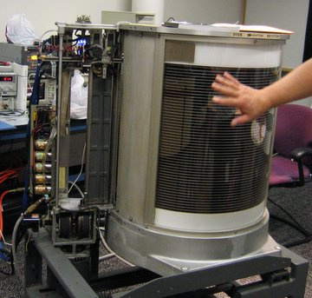
State of the Art Hardware
A partially disassembled IBM 350 (RAMAC),
Circa 1956
Total storage space?
3.75 MB
across fifty 24” platters
Notes:
1980: IBM introduces the first gigabyte hard drive. It is the size of a refrigerator, weighs about 550 pounds, and costs $40,000.
1983: Rodime releases the first 3.5-inch hard drive; the RO352 includes two platters and stores 10MB.
1986: The official SCSI spec is released; Apple Computer's Mac Plus is one of the first computers to use it.
1988: Prairie Tek releases the 220, the first 2.5-inch hard drive designed for the burgeoning notebook computer market; it uses two platters to store 20MB.
1988: Connor introduces the first 1-inch-high 3.5-inch hard drive, which is still the common form factor. Before this, hard drives were either full height or half-height.
1992: Seagate is first to market with a 7200-revolutions-per-minute hard drive, the 2.1GB Barracuda.
1994: Western Digital develops Enhanced IDE, an improved hard drive interface that breaks the 528MB-throughput barrier. EIDE also allows for attachment of optical and tape drives.
1997: IBM introduces the first drive using giant magneto resistive (GMR) heads, the 16.8GB Deskstar 16GP Titan, which stores 16.8GB on five 3.5-inch platters.
2002: Seagate scores another first with the Barracuda ATA V SATA drive.

Slide 7
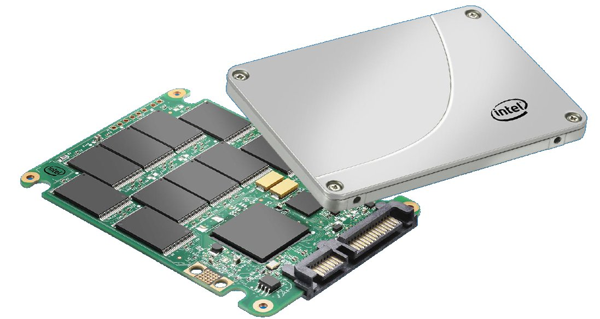
State of the Art Hardware
Total storage space?
200 GB across 10 NAND chips
A partially disassembled Intel SSD
Notes:
In 1978 - a gigabyte of RAM SSD would have cost $1 million. Texas Memory Systems introduced a 16 kilobyte RAM-based solid state disk system designed to accelerate field seismic data acquisition for oil companies.
In 1982 - SemiDisk Systems (based in Beaverton Oregon) became the first company to ship SSD accelerators for the Intel microprocessor based PC market.
In 1987 EMC introduced SSD storage for the mini-computer market, which was the hottest part of the server market at that time. EMC's SSDs were 20x faster than the then available hard disks. But market forces and losses led to EMC exiting the "memory enhancement" business soon after.
In 1996 - ATTO Technology marketed the SiliconDisk II. It was a 5.25" form factor SCSI-3 interface RAM SSD with 64MB to 1.6GB capacity. Throughput was 80MB/s, and performance was 22,000 IOPS.
In 1999 - BiTMICRO launched an 18GB 3.5" flash SSD.
In June 2001 - Adtron shipped the world's highest capacity 3.5" flash SSD. The S35PC had 14 gigabytes capacity and cost $42,000.
April 2005 - Solid Access Technologies made the first SSD with a Serial Attached SCSI interface. (SAS)
In March 2008 - OCZ entered the SSD market with a 2.5" flash SSD

Slide 8
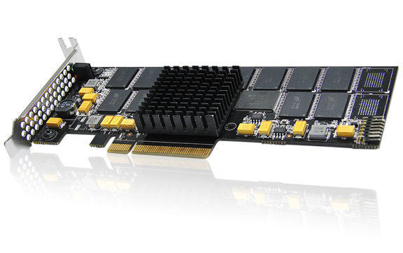
State of the Art Hardware
Total storage space?
1.6 TB
across 12 NAND chips
A partially disassembled PCIe SSD
Notes:
2009 - search volume for PCIe SSDs surpassed that for any other SSD form factor - knocking 2.5" SSDs off the #1 slot.
SATA 3 – 600 MB/s
PCIe – 2,800 MB/s

Slide 9
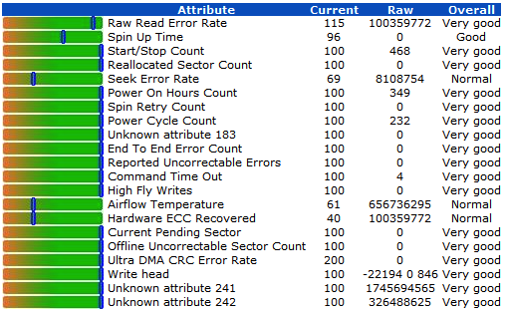
S.M.A.R.T. aka “I’m not dead yet!”
Places where a hard drive can fail:
Controller, electronic components
Hardware – platter arm, motor, mechanical components
Detecting impending failure
with S.M.A.R.T. metrics:
Read Error Rate
Throughput Performance
Spin-Up Time
Start/Stop Count
Seek Error Rate
Seek Time Performance
Power-On Hours (POH)
Spin Retry Count
Recalibration Retries
Power Cycle Count
SSD Erase Fail Count
Unexpected power loss count
Notes:
An early hard disk monitoring technology was introduced by IBM in 1992 in its IBM 9337 Disk Arrays for AS/400 servers using IBM 0662 SCSI-2 disk drives.[5] Later it was named Predictive Failure Analysis (PFA) technology. It was measuring several key device health parameters and evaluating them within the drive firmware. Communications between the physical unit and the monitoring software were limited to a binary result: namely, either "device is OK" or "drive is likely to fail soon”.
Compaq submitted IntelliSafe to the Small Form Factor (SFF) committee for standardization in early 1995.
It was supported by IBM, by Compaq's development partners Seagate, Quantum, and Conner, and by Western Digital, which did not have a failure prediction system at the time. The Committee chose IntelliSafe's approach, as it provided more flexibility. The resulting jointly developed standard was named SMART.
Each drive manufacturer defines a set of attributes, and sets threshold values beyond which attributes should not pass under normal operation. Each attribute has a raw value, whose meaning is entirely up to the drive manufacturer (but often corresponds to counts or a physical unit, such as degrees Celsius or seconds), a normalized value, which ranges from 1 to 253 (with 1 representing the worst case and 253 representing the best) and a worst value, which represents the lowest recorded normalized value.

Slide 10
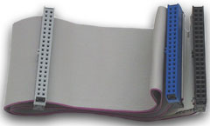
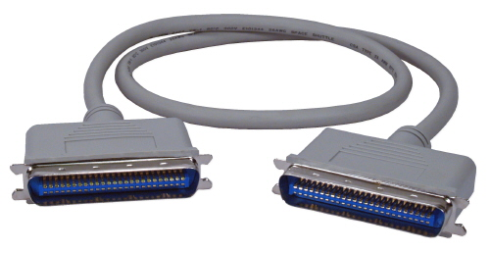
Storage Device Interfaces
EIDE / Parallel ATA and SCSI
Notes:
The first version of what is now called the ATA/ATAPI interface was developed by Western Digital under the name Integrated Drive Electronics (IDE).
Parallel ATA cables transfer data 16 bits at a time. The traditional cable uses 40-pin connectors attached to a ribbon cable. Each cable has two or three connectors, one of which plugs into an adapter interfacing with the rest of the computer system. The remaining connector(s) plug into storage devices, most commonly hard disk drives or optical drives.
ATA's cables have had 40 wires for most of its history (44 conductors for the smaller form-factor version used for 2.5" drives—the extra four for power), but an 80-wire version appeared with the introduction of the Ultra DMA/33 (UDMA) mode.
In 1994, about the same time that the ATA-1 standard was adopted, Western Digital introduced drives under a newer name, Enhanced IDE (EIDE).
Parallel ATA – 40 pin - cables have a maximum allowable length of only 18 inches.
Max throughput – 100 Mbps
SCSI (Small Computer System Interface)
Parallel SCSI (formally, SCSI Parallel Interface, or SPI) is one of the interface implementations in the SCSI family. In addition to being a data bus, SPI is a parallel electrical bus: There is one set of electrical connections stretching from one end of the SCSI bus to the other. A SCSI device attaches to the bus but does not interrupt it. Both ends of the bus must be terminated.

Slide 11
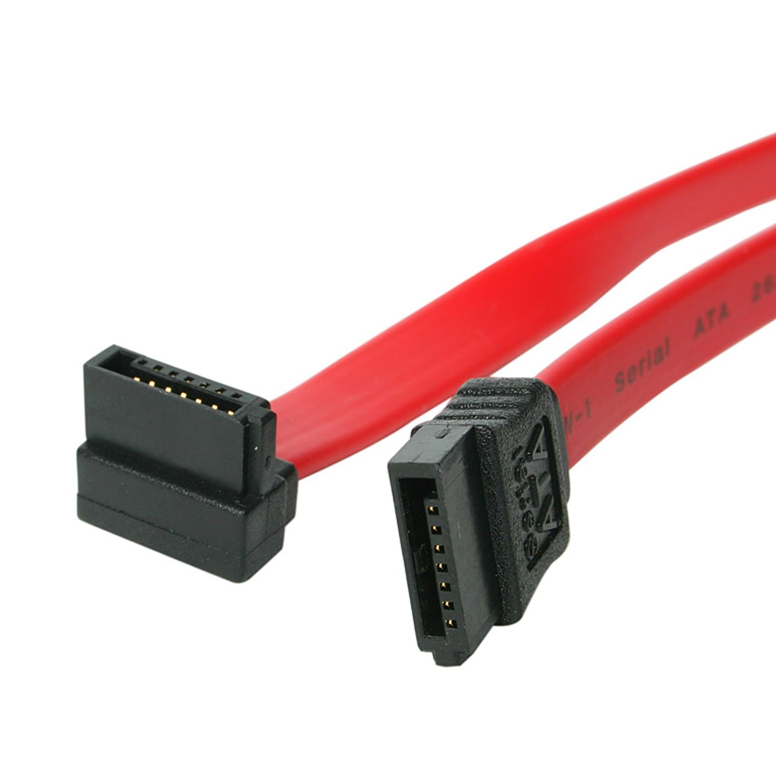
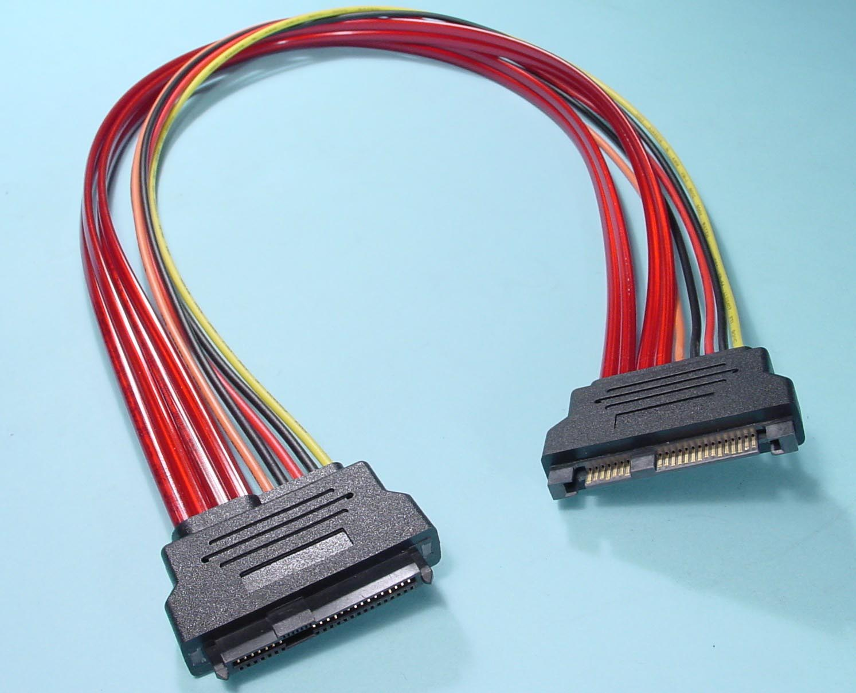
Storage Device Interfaces
SATA and SAS (and fibre channel)
Notes:
Serial ATA (SATA, abbreviated from Serial AT Attachment) is a computer bus interface that connects host bus adapters to mass storage devices such as hard disk drives and optical drives.
Serial ATA succeeded the older Parallel ATA (PATA) standard, offering several advantages over the older interface: reduced cable size and cost (seven conductors instead of 40 or 80), native hot swapping, faster data transfer through higher signaling rates, and more efficient transfer through an (optional) I/O queuing protocol.
The Serial ATA Spec includes logic for SATA device hotplugging. Devices and motherboards that meet the interoperability specification are capable of hot plugging.
SATA revision 3.0 (6 Gbit/s, 600 MB/s)
Modern SCSI (SAS) (6 Gbit/s, 600 MB/s)
Recent versions of SCSI—​Serial Attached SCSI (SAS), SCSI-over-Fibre Channel Protocol (FCP), and USB Attached SCSI (UAS)—​break from the traditional parallel SCSI standards and perform data transfer via serial communications. Although much of the SCSI documentation talks about the parallel interface, all modern development efforts use serial interfaces. Serial interfaces have a number of advantages over parallel SCSI, including higher data rates, simplified cabling, longer reach, and improved fault isolation. The primary reason for the shift to serial interfaces is the clock skew issue of high speed parallel interfaces, which makes the faster variants of parallel SCSI susceptible to problems caused by cabling and termination
SAS vs SATA
Make no mistake, though their serial interfaces make them appear quite similar, SAS and SATA drives are vastly different. SAS drives are engineered for rugged enterprise duty and every component (drive motor, spindle, actuator, magnetic recording heads, control and servo processors, firmware, etc.) is specifically designed and manufactured for that rigorous use. SATA drives are impressive examples of clever engineering to achieve great capacity at low cost, but they are in no way capable of meeting the performance and reliability standards demanded in high-availability enterprise storage applications.
Interoperability:
SAS controllers can handle both SAS and SATA drives. SATA controllers cannot talk to SAS drives, only SATA drives.
SAS connectors have an extra set of pins and a lockout feature, so SATA cables/connectors will not fit on a SAS drive. SAS cables, however, will work with SATA drives.

Slide 12
File Systems
File system – merely a known method of arranging information on a storage device. Essentially, where file 1 stops and file 2 begins.
Common file systems:
FAT (file allocation table): created in 1977, updated in FAT12, FAT16 and FAT32. Max file size? 4 GB.
NTFS (New Technology File System): Created in 1993 for WindowsNT, max file size? 16 TB, and 256 TB on Windows Server 2008+
ext 2,3 and 4 (Extended File System): Created in 1992 for Linux. Max file size? 16 TB
Notes:
FAT: Originally designed in 1977 for use on floppy disks, FAT was soon adapted and used almost universally on hard disks throughout the DOS and Windows 9x eras for two decades.
NTFS has several technical improvements over FAT and HPFS (High Performance File System), the file systems that it superseded, such as improved support for metadata, and the use of advanced data structures to improve performance, reliability, and disk space utilization, plus additional extensions, such as security access control lists (ACL) and file system journaling.
ext: The extended file system, or ext, was implemented in April 1992 as the first file system created specifically for the Linux kernel. It has metadata structure inspired by the traditional Unix File System (UFS) and was designed to overcome certain limitations of the MINIX file system. It was the first implementation that used the virtual file system (VFS), for which support was added in the Linux kernel in version 0.96c, and it could handle file systems up to 2 gigabytes (GB) in size.

Slide 13
File Systems
Journaled vs non Journaled file systems:
A journaling file system is a file system that keeps track of changes not yet committed to the file system's main part by recording the intentions of such changes in a data structure known as a "journal", which is usually a circular log. In the event of a system crash or power failure, such file systems can be brought back online quicker with lower likelihood of becoming corrupted
Example unjournaled file systems:
FAT32
Ext2
Example journaled file systems:
NTFS
ext3 and ext
Notes:
A journaling file system is a file system that keeps track of changes not yet committed to the file system's main part by recording the intentions of such changes in a data structure known as a "journal", which is usually a circular log. In the event of a system crash or power failure, such file systems can be brought back online quicker with lower likelihood of becoming corrupted
Using ext2 for performance when journaling is too much overhead.

Slide 14
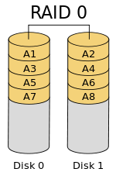
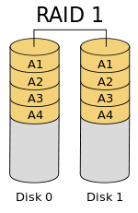
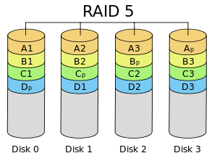
R.A.I.D. (Redundant Array of Inexpensive Disks)
A few common RAID types
Notes:
RAID 0 (also known as a stripe set or striped volume) splits ("stripes") data evenly across two or more disks, without parity information, redundancy, or fault tolerance. Since RAID 0 provides no fault tolerance or redundancy, the failure of one drive will cause the entire array to fail; as a result of having data striped across all disks, the failure will result in total data loss. This configuration is typically implemented having speed as the intended goal.
RAID 1 consists of an exact copy (or mirror) of a set of data on two or more disks; a classic RAID 1 mirrored pair contains two disks. This configuration offers no parity, striping, or spanning of disk space across multiple disks, since the data is mirrored on all disks belonging to the array, and the array can only be as big as the smallest member disk. This layout is useful when read performance or reliability is more important than write performance or the resulting data storage capacity. The array will continue to operate so long as at least one member drive is operational.
RAID 5 consists of block-level striping with distributed parity. Unlike in RAID 4, parity information is distributed among the drives. It requires that all drives but one be present to operate. Upon failure of a single drive, subsequent reads can be calculated from the distributed parity such that no data is lost. RAID 5 requires at least three disks.

Slide 15
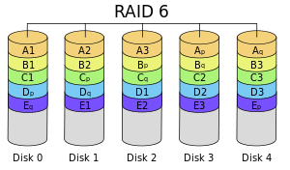
R.A.I.D. (Redundant Array of Independent Disks)
A few common RAID types
Notes:
RAID 6 extends RAID 5 by adding another parity block; thus, it uses block-level striping with two parity blocks distributed across all member disks.
According to the Storage Networking Industry Association (SNIA), the definition of RAID 6 is: "Any form of RAID that can continue to execute read and write requests to all of a RAID array's virtual disks in the presence of any two concurrent disk failures.

Slide 16

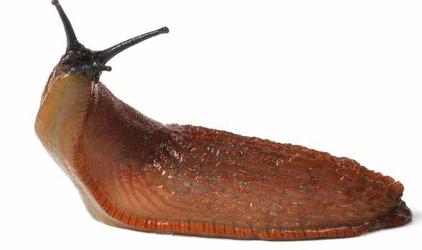
Disk latency vs RAM latency
Notes:
A split I/O may result from requesting data in a size that is too large to fit into a single I/O or that the disk is fragmented on single-disk systems.
Disk I/O encompasses the input/output operations on a physical disk. If you’re reading data from a file on a disk, the processor needs to wait for the file to be read (the same goes for writing).
The killer when working with a disk? Access time. This is the time required for a computer to process a data request from the processor and then retrieve the required data from the storage device. Since hard disks are mechanical, you need to wait for the disk to rotate to the required disk sector.
Disk latency is around 13ms, but it depends on the quality and rotational speed of the hard drive. RAM latency is around 83 nanoseconds. How big is the difference? If RAM was an F-18 Hornet with a max speed of 1,190 mph (more than 1.5x the speed of sound), disk access speed is a banana slug with a top speed of 0.007 mph.

Slide 17
I/O and Split I/O
How one IO request turns into four:
1024 kb IO request from application ->
kernel memory ->
file buffer pool ->
device driver buffer (512 kb) ->
disk buffer ->
disk (256 kb)
Notes:
I/O requests are ultimately broken down to the size of a disk sector or block. At the prerogative of the device driver, some requests can be chained across multiple blocks. But you will not get a clear picture of what is happening from any command line tool, and you ought not have to be concerned with it. I/O requests are first made to the file buffer pool (so that multiple changes to a single point in the file can be lumped into just one disk write. The writes themselves are, to a great extent, "lazy."

Slide 18
Remote Storage
NFS, NAS, SAN, storage fabric – what are all these things? And why does EMC think I’m King Midas?
NFS (Network File System) – allows remote shares to be mounted as a drive
NAS (Network Attached Storage) – Remote storage device, can use NFS, has a file system
SAN (Storage Area Network) – Block based storage, looks like an attached disk

Slide 19
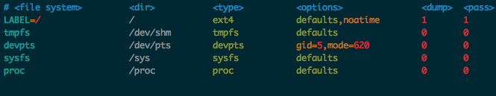
/etc/fstab and noatime
What do all of these things mean?
Notes:
file system The partition or storage device to be mounted.
dir The mountpoint where <file system> is mounted to.
type The file system type of the partition or storage device to be mounted. Many different file systems are supported: ext2, ext3, ext4, btrfs, reiserfs, xfs, jfs, smbfs, iso9660, vfat, ntfs, swap and auto. The auto type lets the mount command guess what type of file system is used. This is useful for optical media (CD/DVD).
options Mount options of the filesystem to be used. See the mount man page. Please note that some options are specific to filesystems; to discover them see below in the aforementioned mount man page.
dump Used by the dump utility to decide when to make a backup. Dump checks the entry and uses the number to decide if a file system should be backed up. Possible entries are 0 and 1. If 0, dump will ignore the file system; if 1, dump will make a backup. Most users will not have dump installed, so they should put 0 for the dump entry. p
Pass Used by fsck to decide which order filesystems are to be checked. Possible entries are 0, 1 and 2. The root file system should have the highest priority 1 (unless its type is btrfs, in which case this field should be 0) - all other file systems you want to have checked should have a 2. File systems with a value 0 will not be checked by the fsck utility.

Slide 20
File properties
immutable bit
guid
uuid
sticky bit

Slide 21
Paths
symlinks vs hard links
relative vs absolute paths
cd . and cd ..

Slide 22
Inodes, oh my!
inodes vs files
inode exhaustion

Slide 23
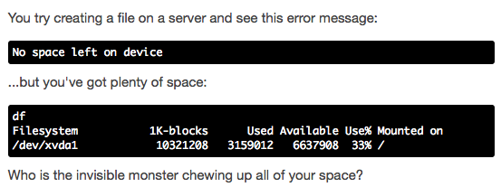
Inodes, oh my!

Slide 24

Inodes, oh my!

Slide 25
Inodes, oh my!
What are inodes?
An index node (or inode) contains metadata information (file size, file type, etc.) for a file system object (like a file or a directory). There is one inode per file system object.
An inode doesn't store the file contents or the name: it simply points to a specific file or directory.

Slide 26
Inodes, oh my!
The problem with inodes
The total number of inodes and the space reserved for these inodes is set when the filesystem is first created. The inode limit can't be changed dynamically and every file system object must have an inode.
While it's unusual to run out of inodes before actual disk space, you are more likely to have inode shortages if:
You are creating lots of directories, symlinks, and small files.
You created your ext3 filesystem with smaller block sizes. The ext3 default block size is 4096 bytes. If you are using your filesystem for storing lots of very small files, you might create the filesystem with a block size of 1024 or 2048. This would let you use your disk space more efficiently, but raises the likelihood of running low on inodes.

Slide 27
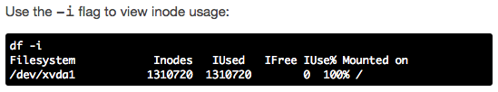
Inodes, oh my!
Viewing inode usage:

Slide 28
Inodes, oh my!
Can I increase the inode limit?
The bad news: on the ext* file systems, you can't simply increase the inode limit on an existing volume. You have two options:
If the disk is an LVM, increase the size of the volume.
Backup and create a new a new file system, specifying a higher inode limit.

Slide 29
Utilities
Cat,
chmod and a quick review of permissions - owner, group, other
cp vs mv
df -h vs du -h
fdisk
find vs locate
fsck - when and when not to
head and tail
Iostat
iotop

Slide 30
Utilities
less vs more (hah hah)
ls
mkdir
mount
Rmdir
rm and when not to rm -r /
rm and rm / my directory/another/directory/where/is/my/file/system?
rsync
stat
touch

Slide 31
Permissions
Who\What r(ead) w(rite) (e)x(ecute)
u(ser) 4 2 1
g(roup) 4 2 1
o(ther) 4 2 1

Slide 32
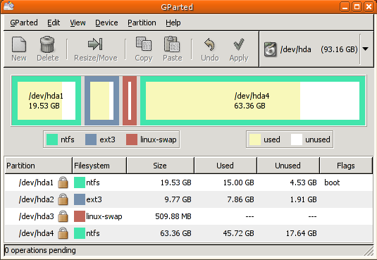
Partitioning and what happens when a partition fills up

Slide 33
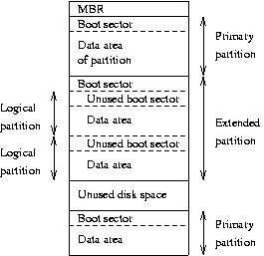
Partitioning and what happens when a partition fills up

Slide 34
SELinux and oh sigh
When and when not to use SELinux, all the things you’ll need to know:
Check for permissive or enforcing mode:
[root@client1 ~]# getenforce
If you get back a 1 selinux is turned on
If you get back a 0 it is turned off.
Switch selinux modes from permissive to enforcing and back:
[root@client1 ~]# setenforce 1 (will set enforcing mode)
[root@client1 ~]# setenforce 0 (will set permissive mode)

Slide 35
Swap - let's just not
Why you shouldn’t use swap

Slide 36
LVM
“I want to abstract my partitioning from the physical devices.”

Slide 37
Linux file system layout - /etc, /opt, yada yada
Directory Content
/bin Common programs, shared by the system, the system administrator and the users.
/boot The startup files and the kernel, vmlinuz. In some recent distributions also grub data.
/dev Contains references to all the CPU peripheral hardware, which are represented as files with special properties.
/etc Most important system configuration files are in /etc, /home Home directories of the common users.
/initrd Information for booting. Do not remove!
/lib Library files, includes files for all kinds of programs needed by the system and the users.
/lost+found Every partition has a lost+found in its upper directory. Files that were saved during failures are here.
/misc For miscellaneous purposes.
/mnt Standard mount point for external file systems, e.g. a hard drive.
/net Standard mount point for entire remote file systems
/opt Typically contains extra and third party software.
/proc A virtual file system containing information about system resources
/root The administrative user's home directory
/sbin Programs for use by the system and the system administrator.
/tmp Temporary space for use by the system, cleaned upon reboot, so don't use this for saving any work!
/usr Programs, libraries, documentation etc. for all user-related programs.
/var Storage for all variable files and temporary files created by users, such as log files, the mail queue, etc.

Slide 38
The End

